Slide 1

Team 06

Slide 2
Project Summary
Product search engine across pre-specified e-commerce websites
Web Application designed to compare and track product prices from different websites
Not a seller website
Track products
Save comparisons

Slide 3
Problem Statement
Intention of the Software | Comparing prices of products from different or same e-commerce websites
Affects/ Who will use the Software | All web browsers
The impact of which of | Cheap products are available at ease
A successful solution would be | A web Application that makes comparison of price and products easy and user-friendly

Slide 4
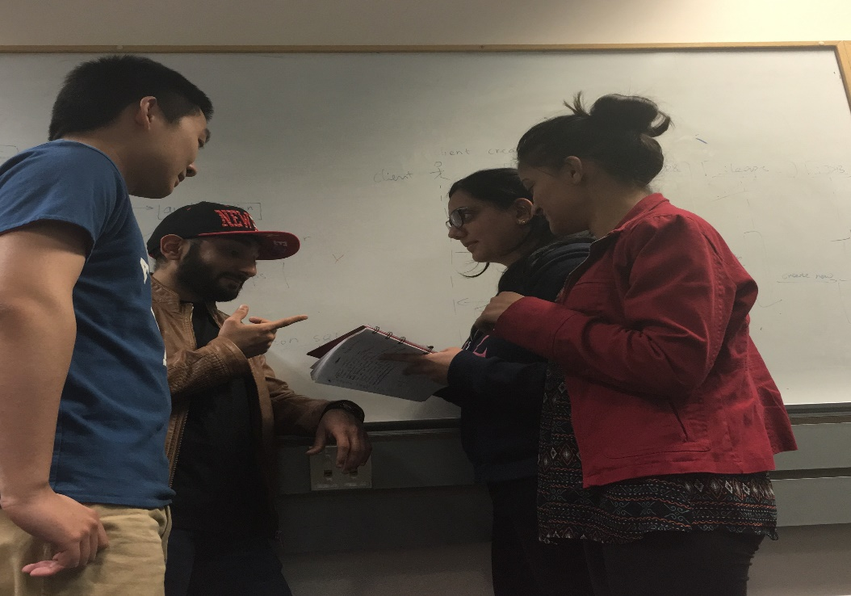
Technologies/Methodologies
MVC / CodeIgniter
PHP/JavaScript
HTML5/CSS3
MySQL
GitHub
Trello
Agile

Slide 5

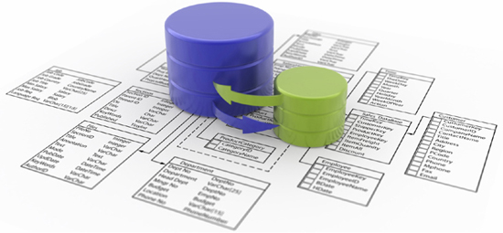
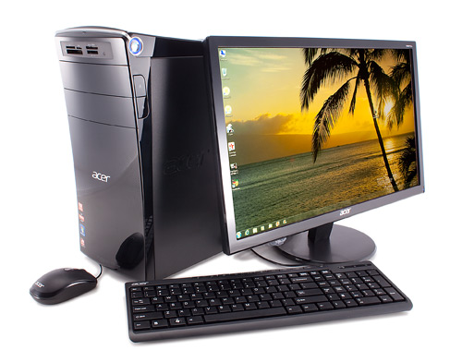
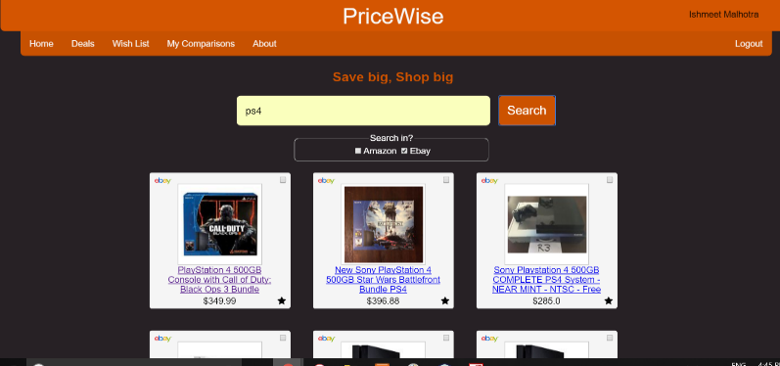
Architecture:
Web Server- Apache
HTTP
TCP/IP
PriceWise
Database - MySQL
Browser

Slide 6
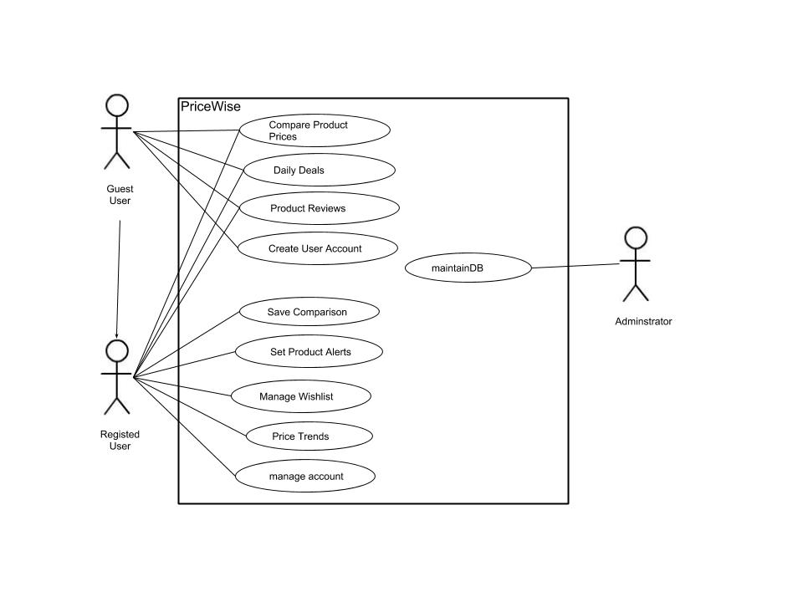
..And Conceptual Use-Case

Slide 7
DEMO

Slide 8
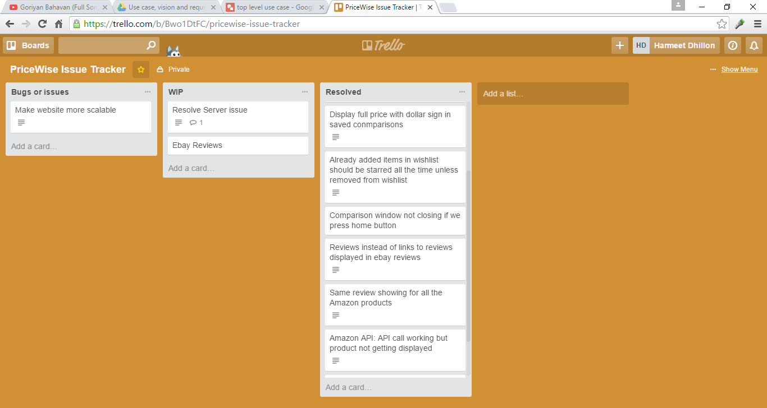
Let’s validate:
Trello to track all the bugs
Testing includes: Unit (CodeIgniter Unit testing class), system, integration, load and performance testing

Slide 9
Still Assertive-> Let us explain.
We are not just comparing prices but also tracking products.
Freedom to save the comparison history
Price trends product wise
Side-by-side comparisons
Freedom to choose website(s) to compare from

Slide 10
Future Scope:
Add more e-commerce websites (e.g. Bestbuy)
Product Ratings under each product
Categorize the items to search items quickly
Search based on the location

